Slide 1




INSTITUTE OF EDUCATION
EPPI-Reviewer and Systematic Reviews
Introductory Workshop
16 June 2020
EPPI-Reviewer Support
EPPISupport@ucl.ac.uk
@EPPIReviewer

Slide 2

Workshop Learning Objectives
To understand…
Systematic review process.
How to access help both in and outside ER.
Basic navigation of ER Web.
Importing references.
Managing duplicates.
Adding and editing coding tools/codes.
Screening.
Data extraction.
Generating reports.
PRISMA diagrams.

Slide 3
Why Systematic Reviews?
How to provide objective evidence to inform practice?
“Rather than looking at any study in isolation, we need to look at the body of evidence” (Nordenbo, 2009, p. 22)
Systematic review:
"a review of research literature using systematic and explicit, accountable methods" (Gough, Oliver & Thomas, 2012, p. 2)
  Transparent and explicit
  Replicable and updatable
  Identify gaps, contradictions or (in)consistencies
Notes:
We see a clear trend towards evidence-based practice and policy. How can we provide objective evidence to inform practice? By conducting primary empirical research that collects data about the real world.
But – as Nordenbo said – "Rather than looking at any study in isolation, we need to look at the body of evidence".
How is this “second-order” data presented in “reality”? In the form of published research.
The aim is to show systematically that existing primary research results contain arguments to shape and inform practice and policies.

Slide 4
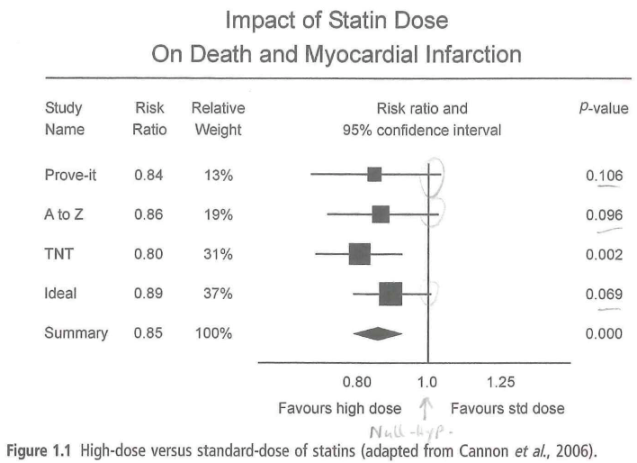

Aggregative v Configurative
Aggregative reviews predominately add up (aggregate) findings of primary studies to answer a review question.
indicate the direction or size of the
effect in a meta-analysis.
Configurative reviews predominately
arrange (configure) the findings of
primary studies to answer the review
question.
offer a meaningful picture of what
research is telling us.

Slide 5
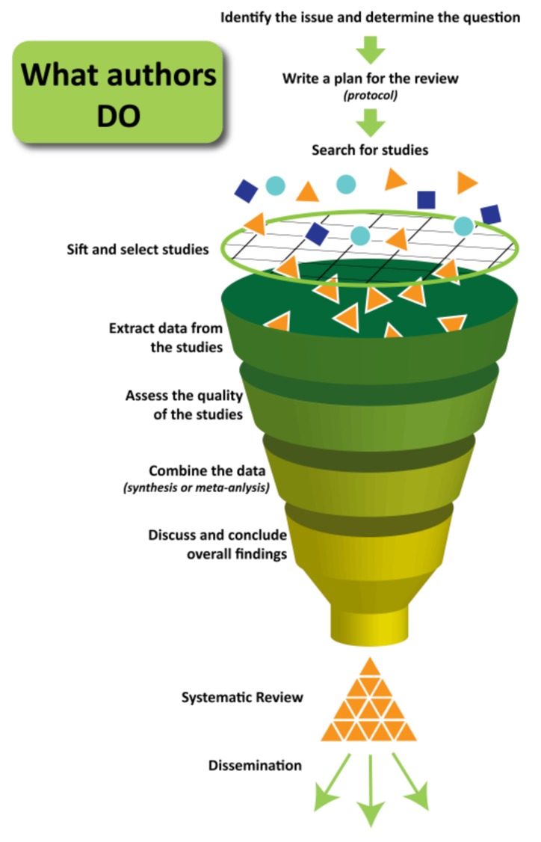
Systematic Review Process
Review question and conceptual framework
Search strategy: search string and selection criteria
Study screening
  Title & Abstract
Study retrieval
Screen on full text
Data Extraction
Quality assessment
Synthesis
Report
Retrieved from YourHealthNet:
http://navigatingeffectivetreatments.org.au/exploring_systematic_reviews.html (12 Feb, 2019)

Slide 6
Study Protocol
Why are protocols important?
Discoverable
Transparent
Replicable
Reduce research bias
Reduce duplication and waste of resources

Slide 7
Study Protocol
Background
  Gives context and provides a summary of PICO(TS).
Summary of existing literature
  Overview of literature that is important to the review question.
  End with a rationale why the question is important.
Research question and aims
Methods
  Search strategy, screening & selecting, quality assessment, data extraction, data analysis.
Time frame

Slide 8
EPPI-Reviewer: What is it for?
EPPI-Reviewer was created to support the methodological work conducted at the EPPI-Centre.
This makes it a Research Tool in two distinct senses:
It enables the production of a range of reviews and analyses (secondary research).
Supports the development of Evidence Synthesis methodologies (research on research methods).
EPPI-Reviewer helps by:
keeping your review process explicit and replicable
enabling you to defend your work
keeping your data in one place
allowing updates to your review

Slide 9
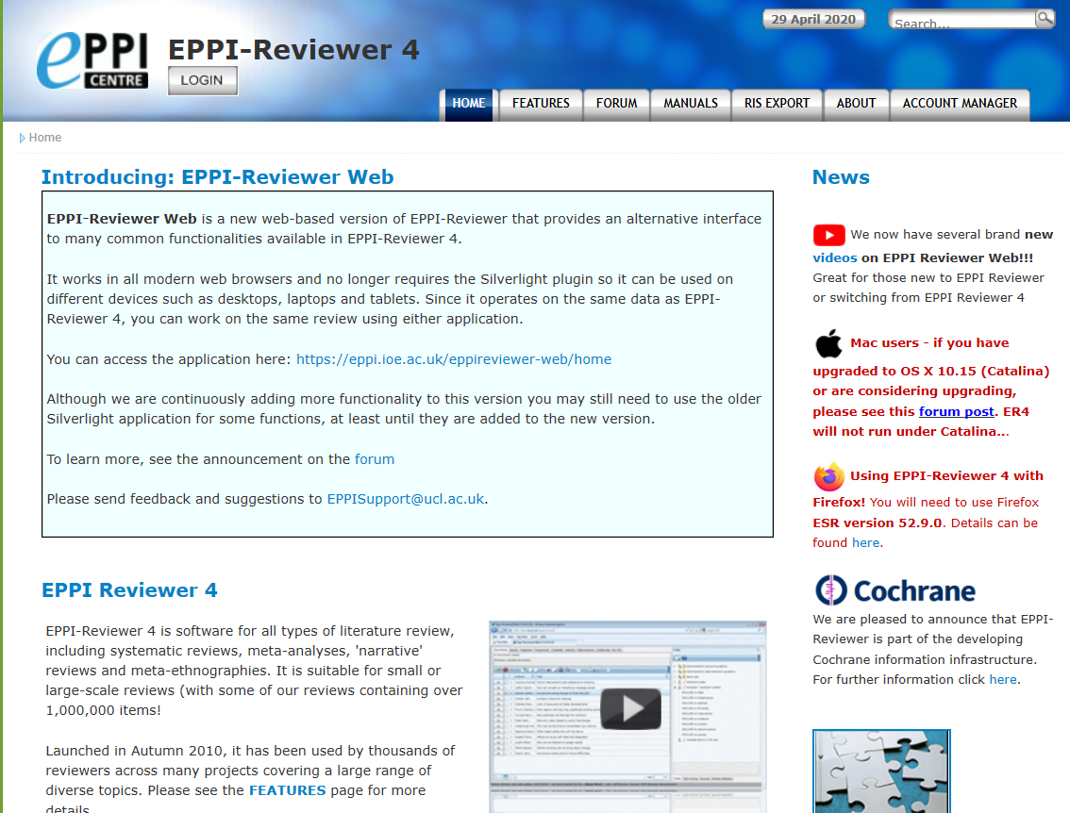
EPPI-Reviewer Gateway
https://eppi.ioe.ac.uk/cms/er4
Access latest information about ER and features
Support forums
User manual, FAQ
Instructional videos
Export to RIS facility
Access to the ER review and account manager

Slide 10
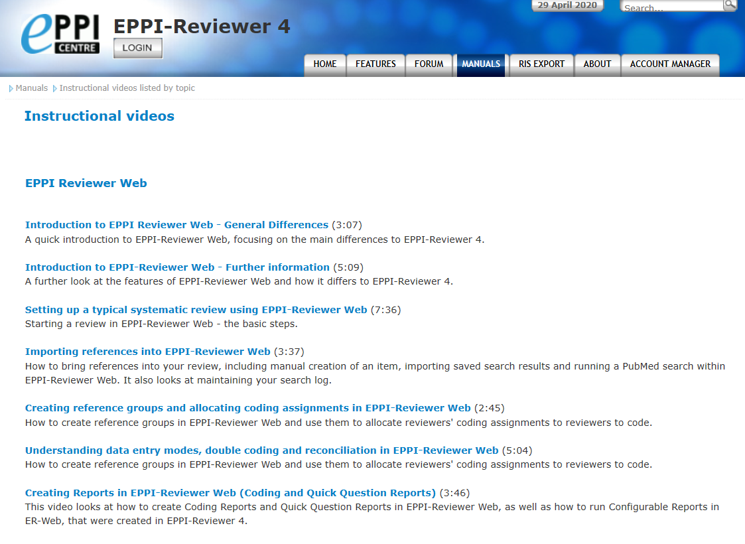
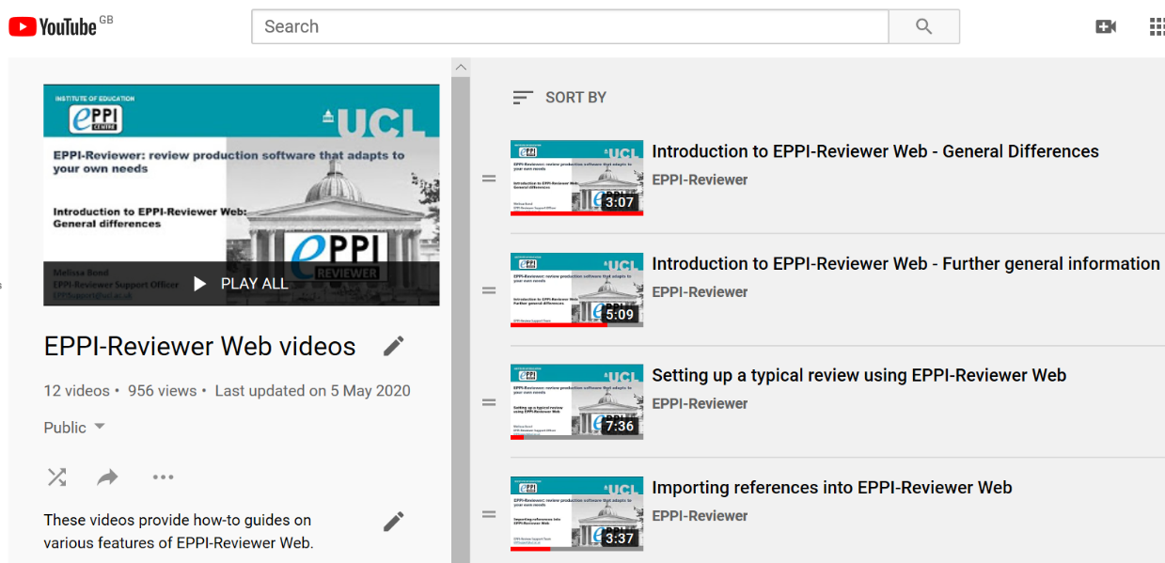
EPPI-Reviewer Instructional Videos
Accessed through EPPI-Reviewer gateway or our YouTube channel.
Video playlists available for General, ER4 and ER Web.
Variety of ER Web topics, including:
  Importing references
  Editing coding tools
  Screening/coding
  Running reports
  Interactive EGM

Slide 11
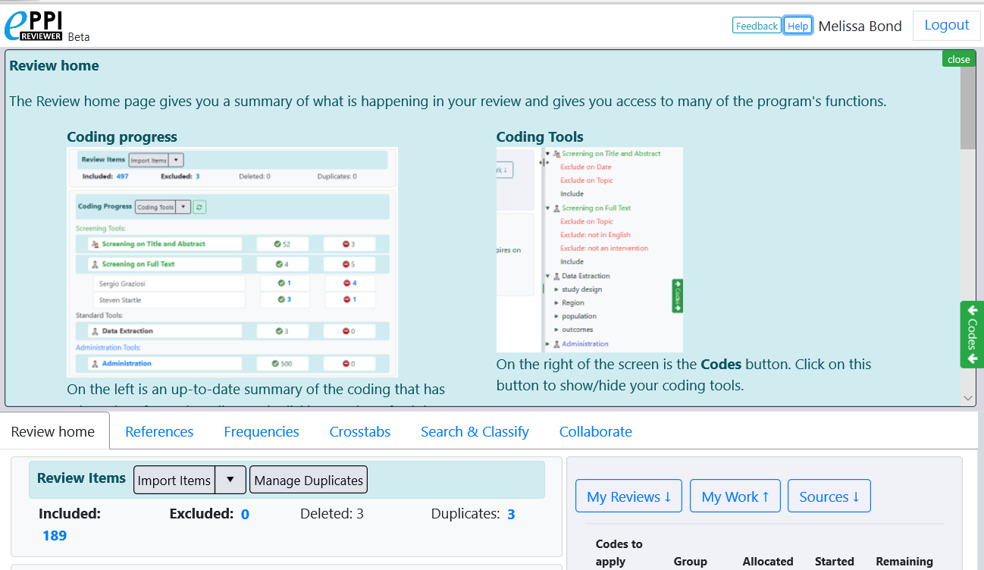
EPPI-Reviewer Web – Home Screen
Click on the blue Help button to view contextual help.
Feedback button is not for support requests – please email EPPISupport@ucl.ac.uk

Slide 12
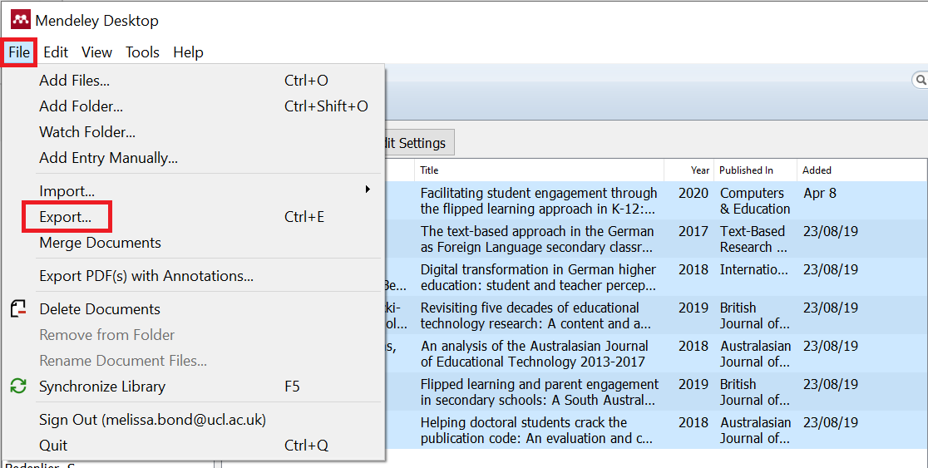
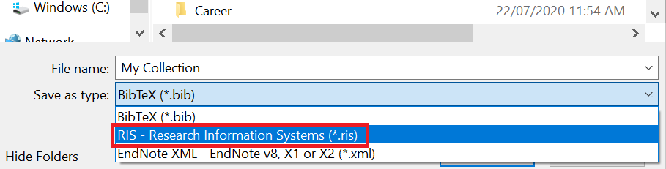
Exporting references from Mendeley
Select the documents that you want to export from Mendeley.
Click on File and then Export.
3. Type in a file name and change the file type to RIS.
4. Save to your device.

Slide 13
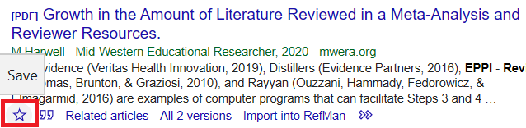
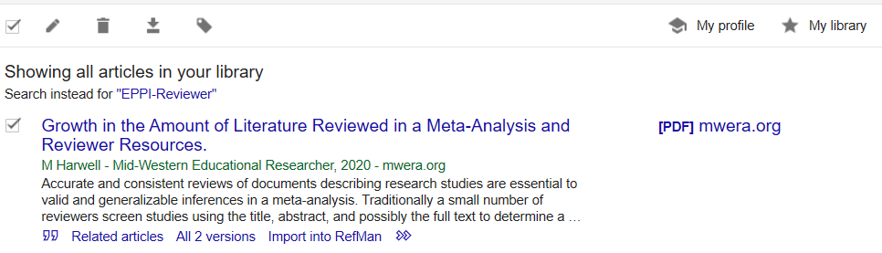
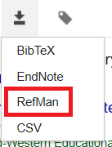
Exporting references from Google Scholar
Ensure that you are logged into Google Scholar.
Conduct your search.
Click on the star at the bottom of an item to save it into your ‘My Library’.
Once you have saved the items to export, click on My Library at the top right.
Select the items you want to export from the list.
Click on the export button.
Choose RefMan.
Save to your device.

Slide 14
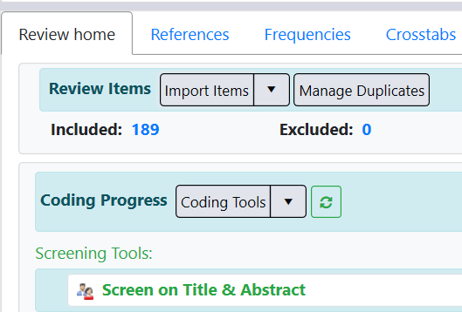
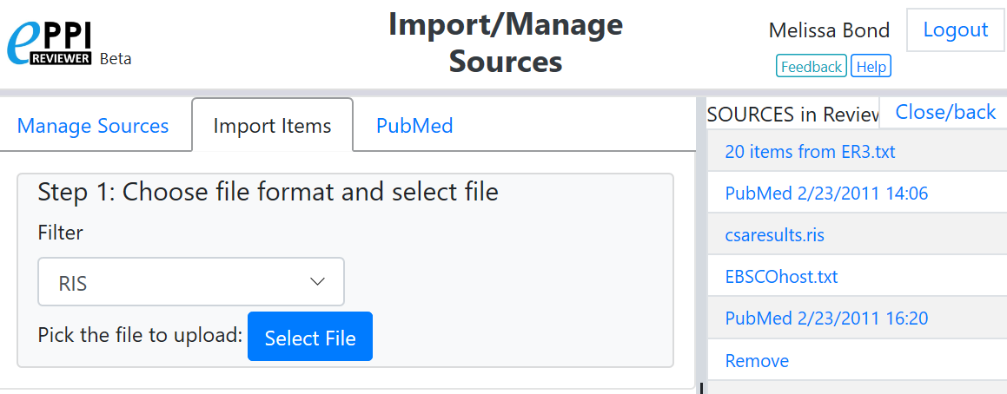
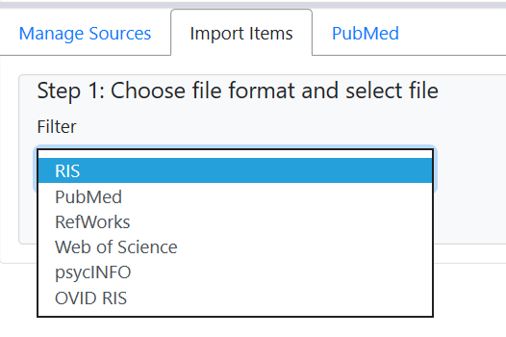
Importing references
Review home tab
Click on the Import items button
The Import/Manage Sources page will be displayed.
Select an import filter.
  RIS for Mendeley & Google Scholar
Find your file and click open.
Video: https://youtu.be/Emkuq5H_FB0

Slide 15
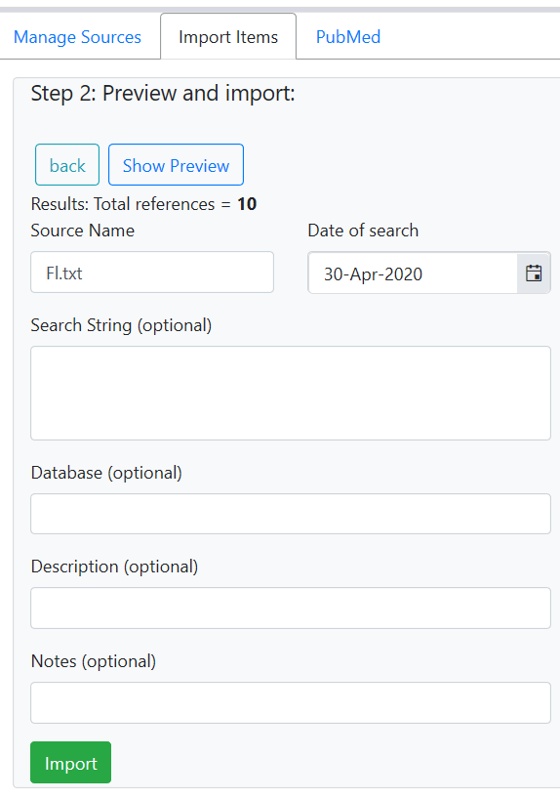
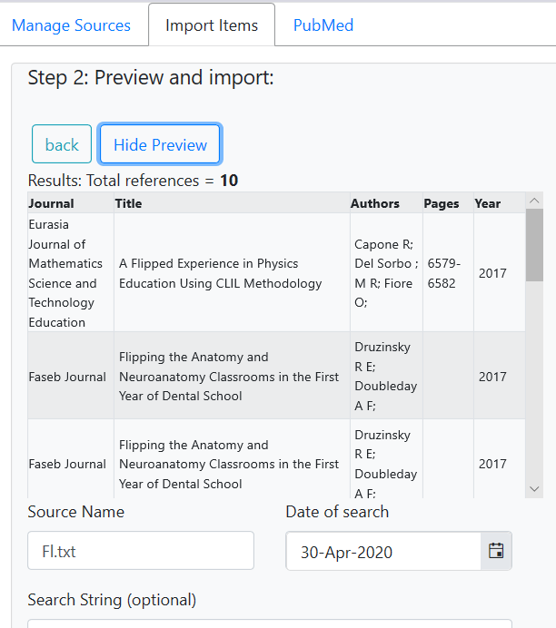
Importing references
Number of items to import will be displayed.
Enter search details if desired, including string, database and date of the search.
Click on the Show Preview button to see items for importing.
Check to see if they appear as you would expect.
Click Hide Preview to collapse.
Click on Import to bring the items into your review.
Video: https://youtu.be/Emkuq5H_FB0

Slide 16
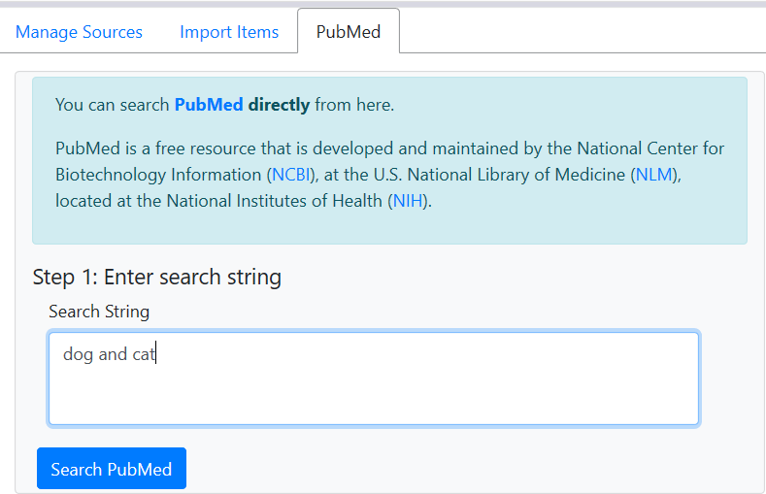
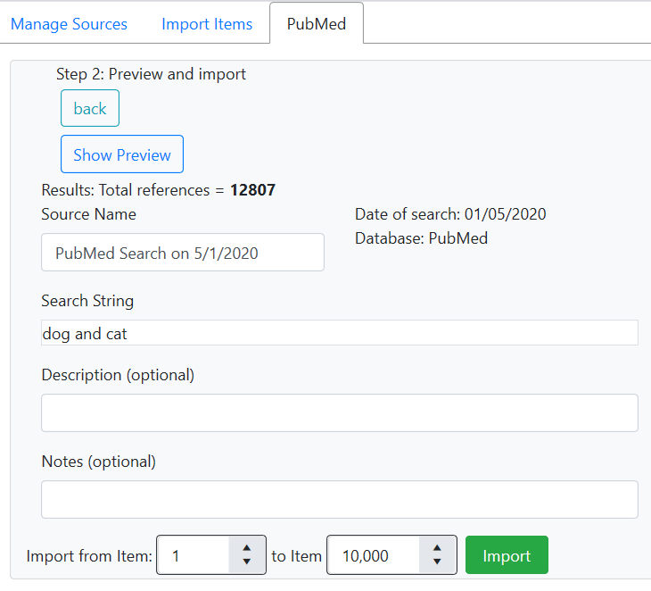
Importing references from PubMed
Click on PubMed tab.
Type in your search terms.
Click Search PubMed and the items will be listed.
Preview items and set the number to import (not too many!)
Click Import to bring the items into your review.
Video: https://youtu.be/Emkuq5H_FB0

Slide 17
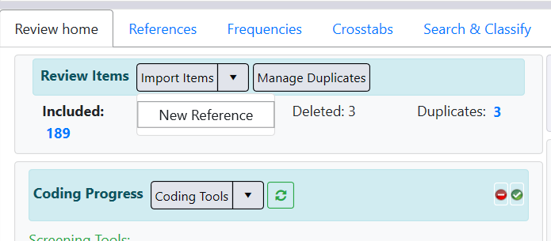
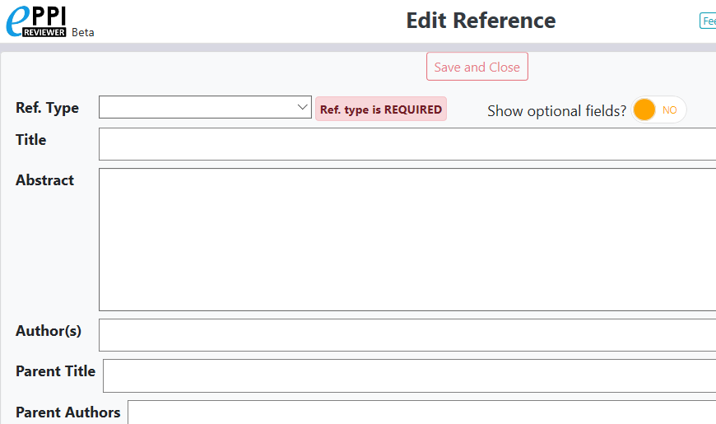
Manually creating an item
Review home tab.
Click on the black arrow next to Import Items.
Click on New Reference.
Enter the citation details in the Edit Reference window.
Be sure to select the correct reference type (e.g. journal article).
When finished, click Save and Close.

Slide 18
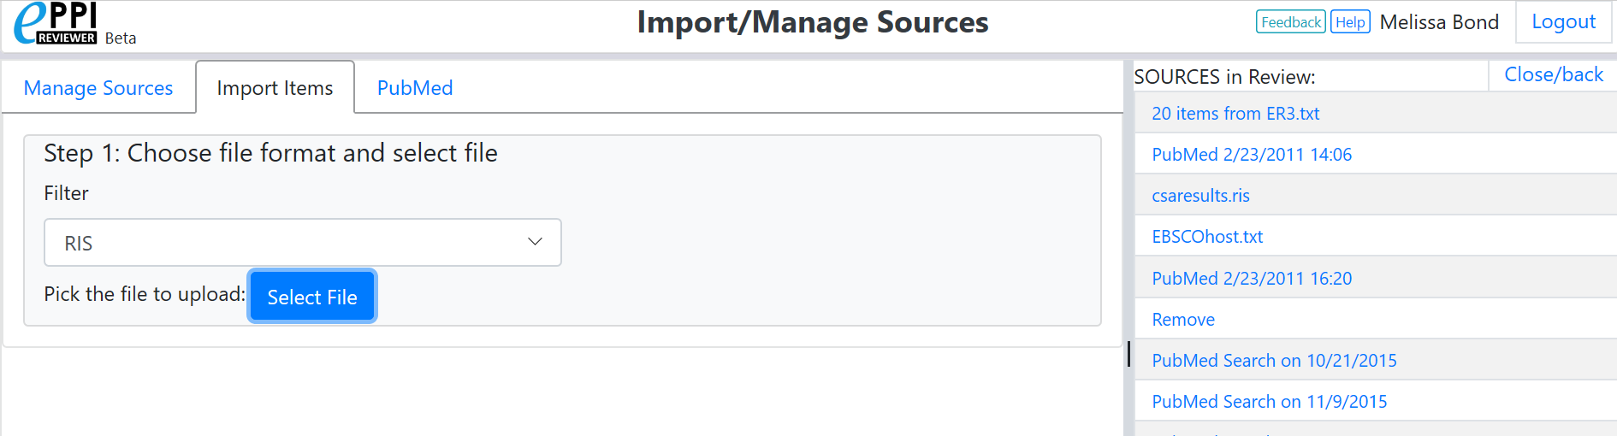
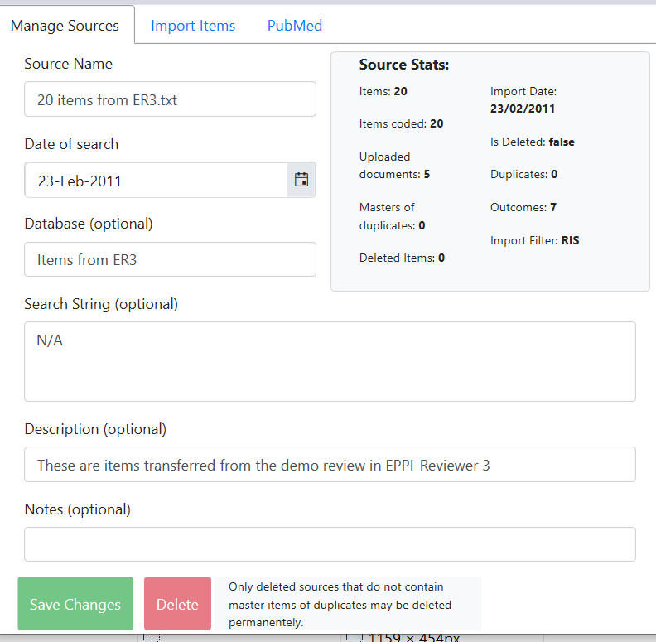
Importing references
A list of sources in the review is also displayed.
  Clicking on one will show you the source information.
To return to the previous screen, click on Close/back in the top right-hand corner.
Video: https://youtu.be/Emkuq5H_FB0

Slide 19
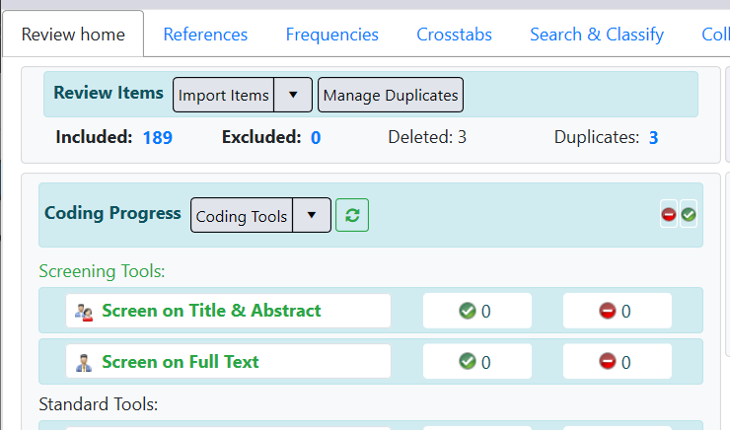
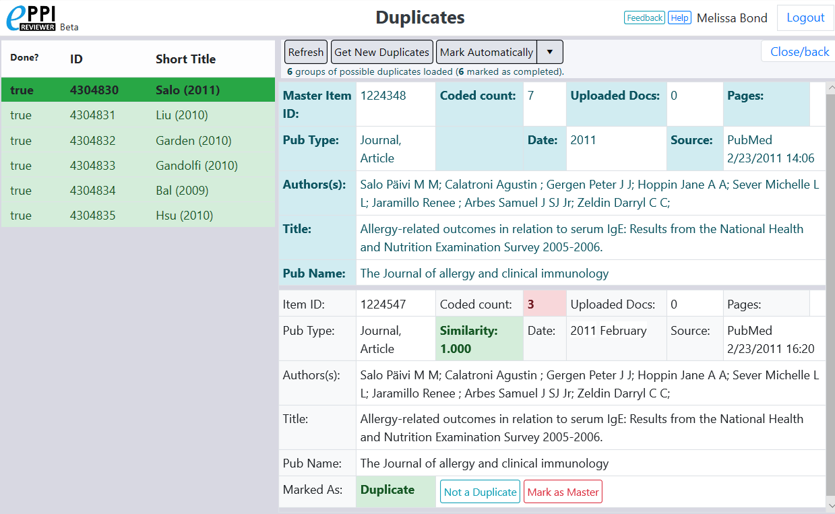
Managing duplicates – ER Web
Clicking the Manage Duplicates button opens the Duplicates window.

Slide 20
Managing duplicates – ER Web
To list duplicates after you have imported all items, click on Get new duplicates.
  Items will be grouped with similar references, with groups displayed on the left (completed groups are marked in green).
  Each item in the group is assigned a similarity score, compared to a Master item.

Slide 21
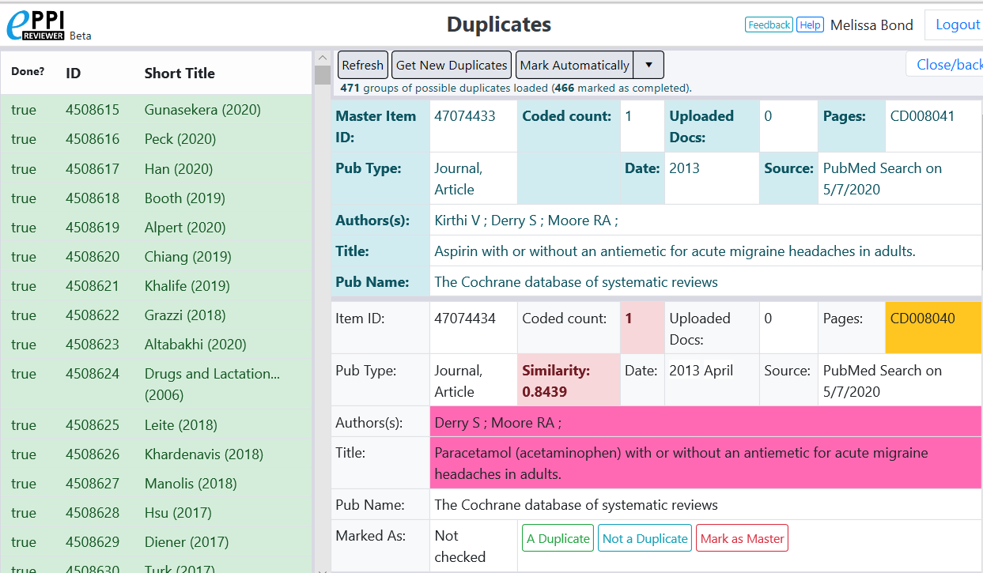
Managing duplicates – ER Web
Mark Automatically will mark all items that have a similarity score of 1.00 as a duplicate. Complete groups are checked off.
  Incomplete groups will highlight any differences.
  User must mark items as A duplicate, Not a duplicate or Mark as Master.

Slide 22
Your next steps
Set up your screening coding tool.
Screen all items on title and abstract, using include/exclude criteria.
Locate and upload PDFs of any items marked as INCLUDE on title & abstract.
Screen the items again, reading the full text.
Set up your data extraction coding tool.
Extract data from the included items.
Run reports to be able to analyse your data.

Slide 23
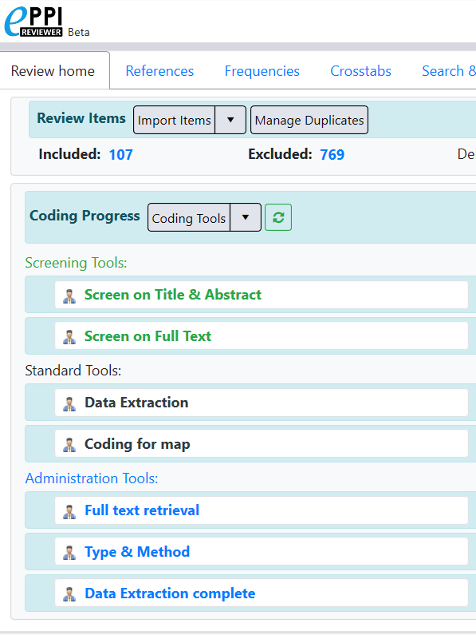
Screening
Screening uses your review inclusion and exclusion criteria.
Screening occurs in two stages and require separate coding tools:
  Screening on title and abstract.
  Screening on full text.
Important to be over-inclusive initially, then apply criteria more strictly to full papers.

Slide 24
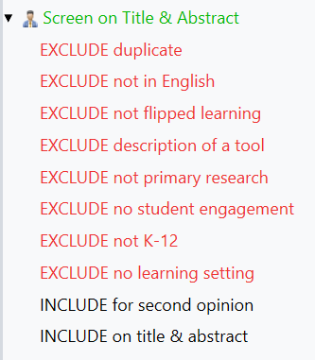

Coding Tool Types
Screening tools
Displayed in green.
Allow 2 types of codes:
  Include
  Exclude
Allows include v exclude comparisons.
Can be in normal or comparison (double coding) data entry mode.
Can only have one level of hierarchy.
  Enables easier production of frequency reports and reconciliation.
Comparison mode
Normal mode

Slide 25
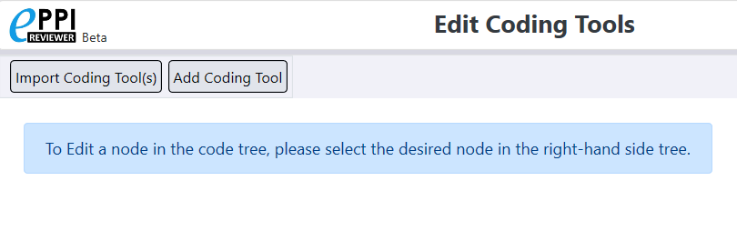
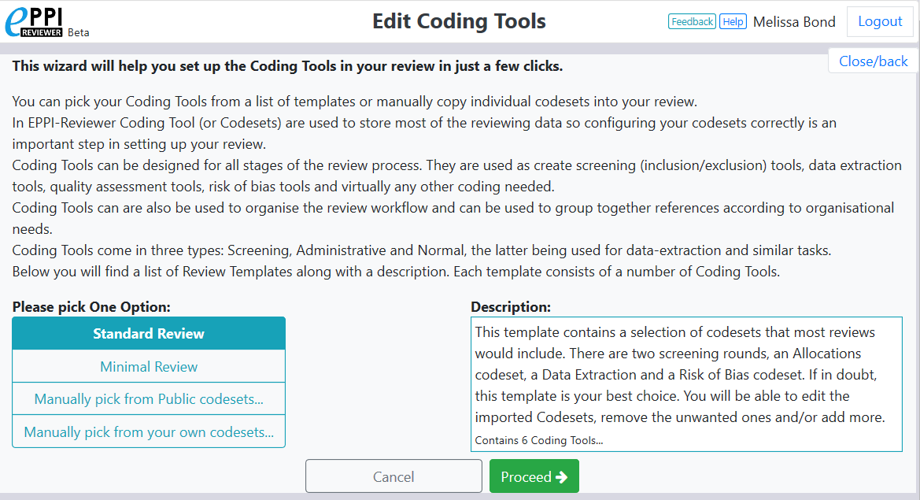
Importing coding tools
Click on Import Coding Tool(s).
Choose the type of coding tool from the list.
Click on Proceed.

Slide 26
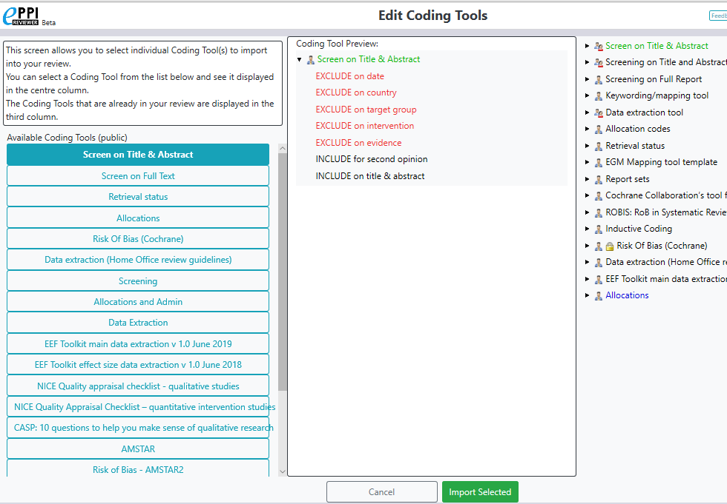
Importing public coding tools
Choose a coding tool.
Preview it.
Click on Import Selected.
  You may need to scroll down to find it.

Slide 27
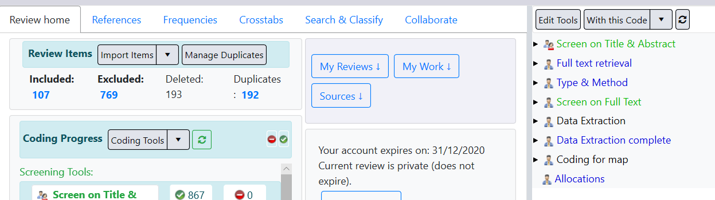
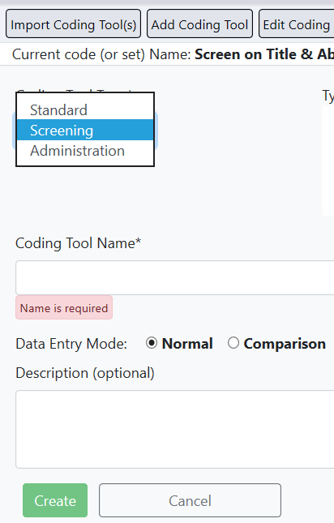
Creating coding tools
Video: https://youtu.be/bGTyqe_ySyA
Either click on Coding Tools or Edit Tools.
Click on Add Coding Tool.
Select the tool type and give the coding tool a name.
Select Normal or Comparison (double) coding.
Click Create.

Slide 28
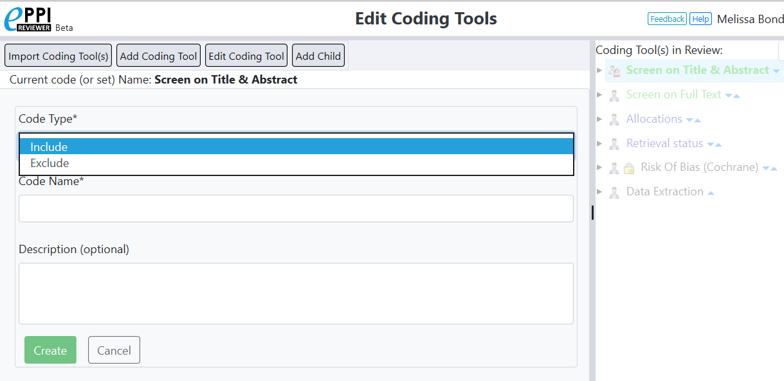
Creating child codes
Video: https://youtu.be/bGTyqe_ySyA
Select a coding tool or code in the panel on the right.
Click on Add Child.
Select Code Type, type in a code name and a description.
Click Create.

Slide 29
Your next steps
Set up your screening coding tool.
Screen all items on title and abstract, using include/exclude criteria.
Locate and upload PDFs of any items marked as INCLUDE on title & abstract.
Screen the items again, reading the full text.
Set up your data extraction coding tool.
Extract data from the included items.
Run reports to be able to analyse your data.

Slide 30
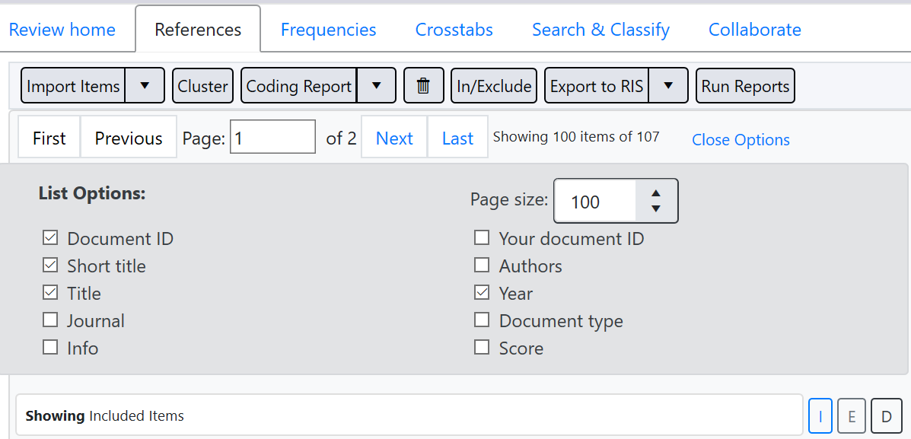
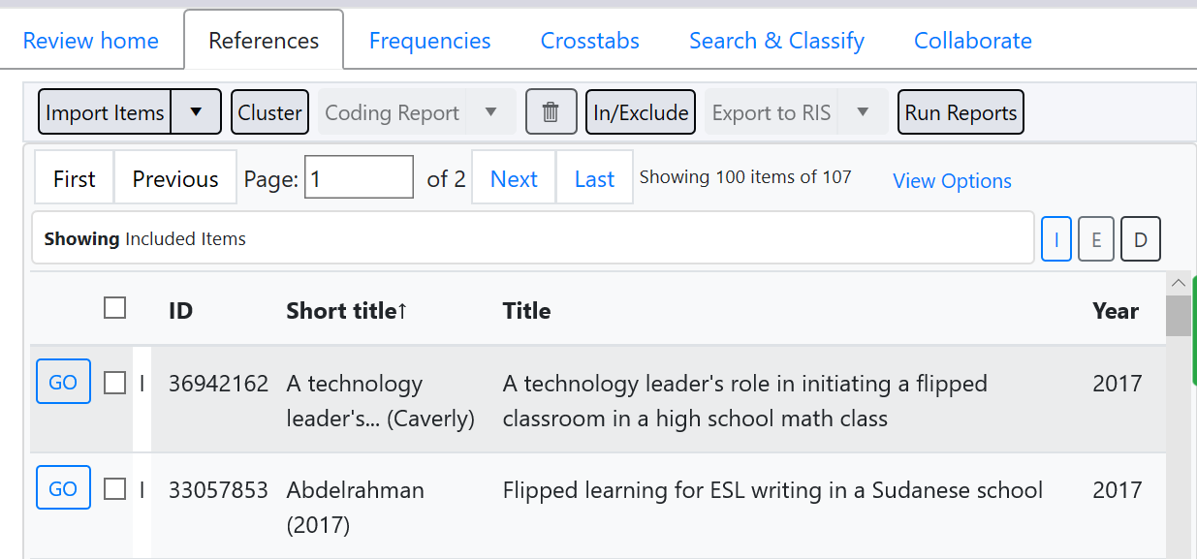
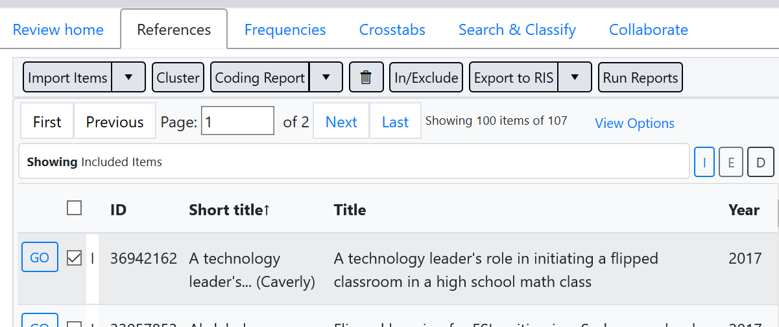
References Tab
Click on View Options to customise your item view.
Change the Page size number, to change the number of items displayed on the page.
Click on GO next to an item to view that record.

Slide 31
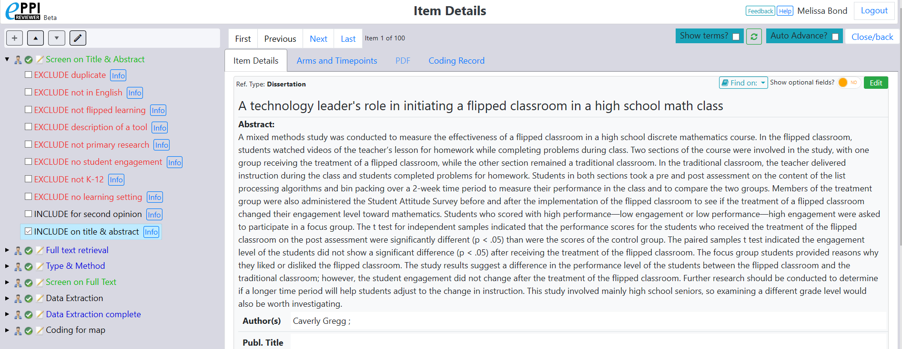
Screening items – ER Web
The EPPI-Reviewer Web Item Details interface.
Coding tool
Navigation
Title
Auto Advance
Info box
Abstract
To edit an item record, you must click on the Edit button

Slide 32
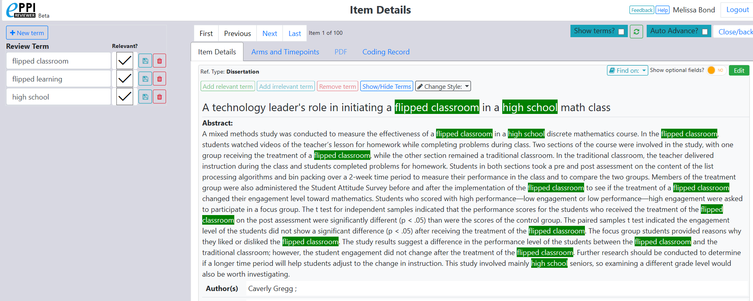
Screening items – ER Web
Customise phrases
Show relevant and irrelevant terms
Add terms or change the style
Find PDF

Slide 33
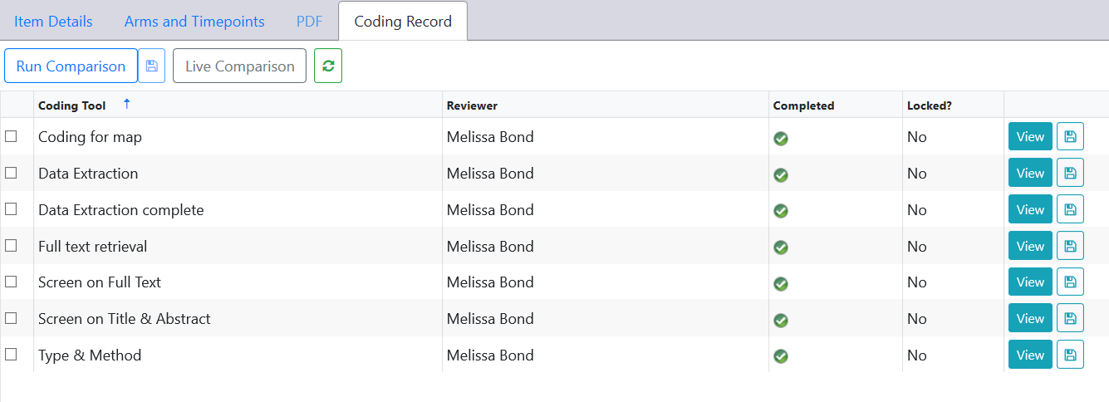
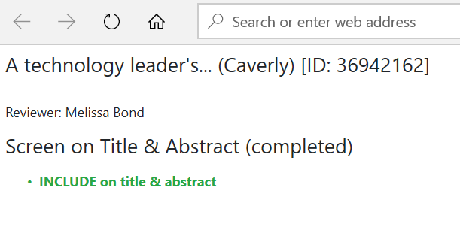
Viewing coding record – ER Web
To see what you have coded at any time, click on Coding record and then View.
Keeps a thorough record of every coding decision made by all review members.

Slide 34
Your next steps
Set up your screening coding tool.
Screen all items on title and abstract, using include/exclude criteria.
Locate and upload PDFs of any items marked as INCLUDE on title & abstract.
Screen the items again, reading the full text.
Set up your data extraction coding tool.
Extract data from the included items.
Run reports to be able to analyse your data.

Slide 35
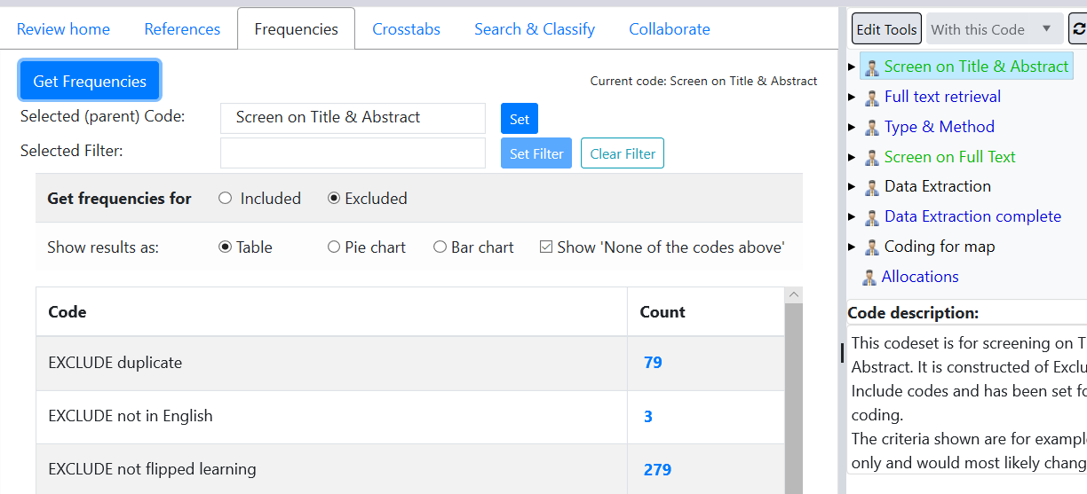
Frequency Report – ER Web
In the Frequencies tab, select the coding tool or parent code, click Set and then Get frequencies.
Frequencies are only retrieved for one level of hierarchy.
Clicking a blue number in the Count column will list those items.
Notes:
Can be filtered and saved in different formats.

Slide 36
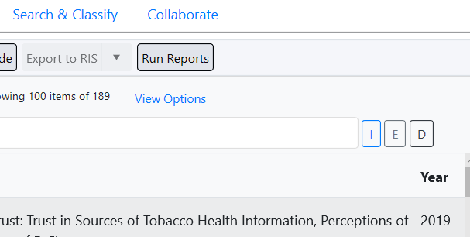
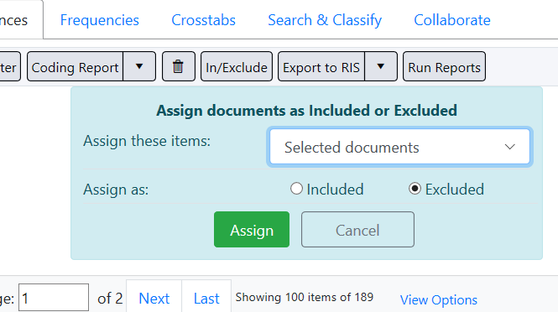
Include, Exclude, Delete flags – ER Web
All items imported into a review are automatically marked as included.
Marking items as Include (I flag), Exclude (E) or Deleted (D), can help organise your review.
You can list items by clicking on the I, E or D icons.
To change an item‘s flag:
Select the item(s)
Click the In/Exclude button for changing to I or E.
Choose selected documents (or a specific code), change Assign as to Included or Excluded and click Assign.
To mark as D click the trash can icon.

Slide 37
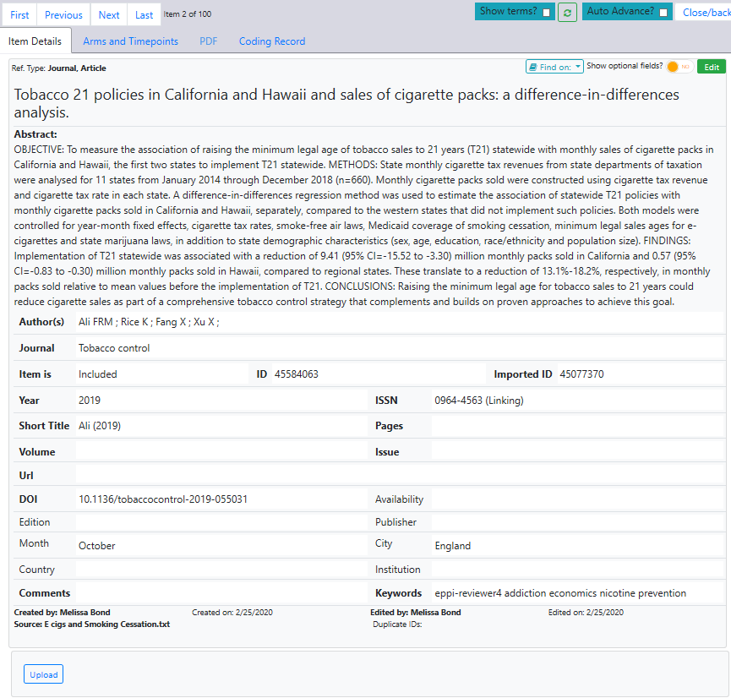
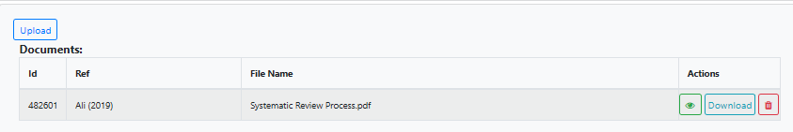
Uploading PDFs
Click on Upload at the bottom of the item record.
Select the file you want to upload and click on Open.
Your file will now appear at the bottom of the item record, in the Documents panel.
To view the PDF, click on the green eye icon.
To delete the PDF, click on the red trash icon.

Slide 38
Your next steps
Set up your screening coding tool.
Screen all items on title and abstract, using include/exclude criteria.
Locate and upload PDFs of any items marked as INCLUDE on title & abstract.
Screen the items again, reading the full text.
Set up your data extraction coding tool.
Extract data from the included items.
Run reports to be able to analyse your data.

Slide 39
Your next steps
Set up your screening coding tool.
Screen all items on title and abstract, using include/exclude criteria.
Locate and upload PDFs of any items marked as INCLUDE on title & abstract.
Screen the items again, reading the full text.
Set up your data extraction coding tool.
Extract data from the included items.
Run reports to be able to analyse your data.

Slide 40
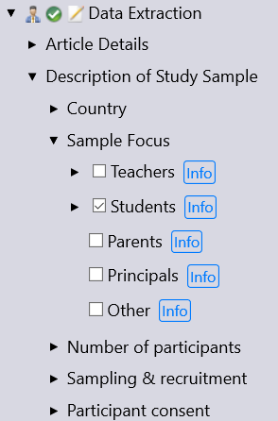
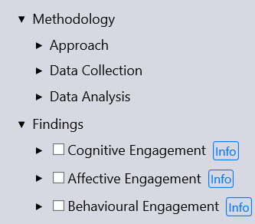
Data Extraction
After screening on full text
Detailed data on methods and results
  Produce a synthesis
May include:
  Information about study sample and study design
  Inductive coding of qualitative text
  Collecting outcome data for statistical meta-analysis
  Study quality and relevance
Try to stick to 3 levels:
  Section (e.g. Sample Description)
  Question (e.g. Sample Focus)
  Answer (e.g. Teachers)

Slide 41
Your next steps
Set up your screening coding tool.
Screen all items on title and abstract, using include/exclude criteria.
Locate and upload PDFs of any items marked as INCLUDE on title & abstract.
Screen the items again, reading the full text.
Set up your data extraction coding tool.
Extract data from the included items.
Run reports to be able to analyse your data.

Slide 42
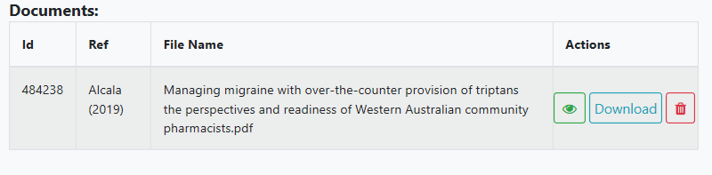
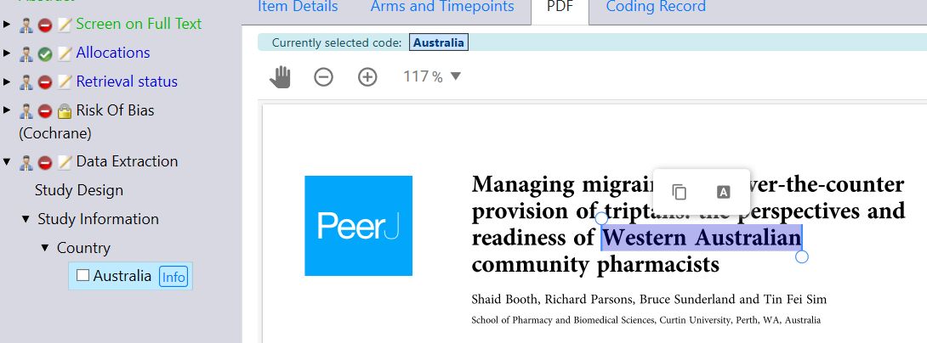
Line by Line PDF Coding – ER Web
Video: https://youtu.be/9eP70M4a9iE
Click on the green eye icon to display the PDF.
Highlight the text in the PDF
you want to code.
Click on the code it should be assigned to.
Click on the Highlight button (Black with an A symbol).

Slide 43
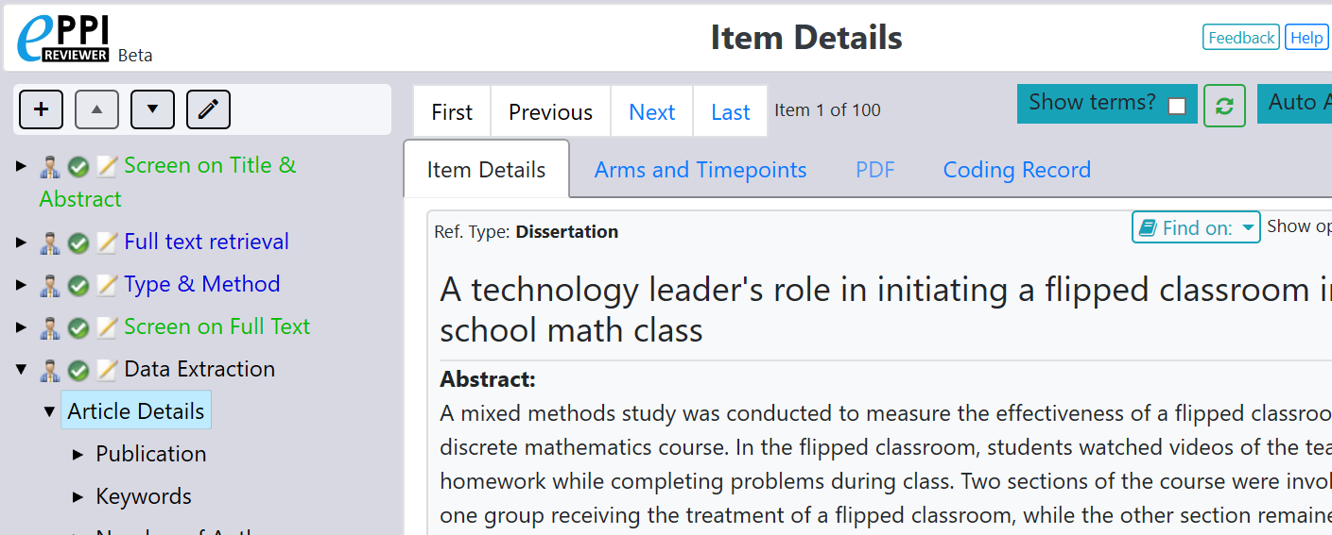


Inductive Coding
To add codes on the fly:
  Click on the coding tool or parent code where you want to add the child code.
  Click on the + icon.
  Choose the code type.
  Type in the code name.
  Click on Create.

Slide 44
Your next steps
Set up your screening coding tool.
Screen all items on title and abstract, using include/exclude criteria.
Locate and upload PDFs of any items marked as INCLUDE on title & abstract.
Screen the items again, reading the full text.
Set up your data extraction coding tool.
Extract data from the included items.
Run reports to be able to analyse your data.

Slide 45



Searching ER Web
Click on New Search.
Choose how you want to search for your items.
Click on Run Search.
Combine searches with boolean operators.
You can also search for items with a specific code by selecting the code in the Codes panel, and clicking on With this Code.

Slide 46

Crosstab Report – ER Web
Optional: filter by a specific code
Choose a parent code for the X-axis and the Y-axis by selecting the code in the Codes panel and clicking Set.
Click on Get Crosstabs.

Slide 47


Coding Reports
Similar to a coding report in ER4.
Select the items to include.
Click on Coding Report.
Choose which coding tools to include.
Click the checkbox next to JSON report? to create a JSON report for an EGM.
Click Get Report.
View/Print opens report tab.
Click the blue save icon to save as a HTML file.
Video: https://youtu.be/iGXgpb4bwFg

Slide 48


Quick Question Reports – ER Web
Similar to a configurable report in ER4.
Select the items to include.
Click the black arrow next to Coding Report.
Click on Quick Question Report.
Choose the parent/question code from any coding tool.
Choose whether to include InfoBox text and line-by-line PDF coding.
Click Get Report.
View/Print opens report tab.

Slide 49


Quick Question Reports – ER Web
Appears below after clicking on Get Report.
Clicking View/Print will open it in a new tab.
Save report as HTML and open in Excel or Word.

Slide 50


Diagram Report – ER4
Can be used to create review flow diagrams (also called PRISMA diagrams) based on the coding you have done.
Click on the Diagrams tab.
Right click a codeset to insert all child codes into the diagram OR right click an individual code to insert it.
Change shapes.
Automatically add code counts.
Save diagram.
Export as PNG file.

Slide 51

Diagram Report – ER4

Slide 52


Meta Analysis

Slide 53
Further Support
Things to keep in mind…
  Without a plan, EPPI-Reviewer is ‘inert’.
  The interface includes many functionalities (e.g. ‘with this code’, ‘assign’, ‘auto advance’, ‘highlights’, etc.)
    it takes time to explore it!
  If you need any help at all, we are here for you!
    EPPISupport@ucl.ac.uk
    Support forum: https://eppi.ioe.ac.uk/cms/Default.aspx?tabid=2932
    FAQ: https://eppi.ioe.ac.uk/cms/Default.aspx?tabid=3384
    YouTube: https://www.youtube.com/user/EPPIReviewer4
Questions / comments?

Slide 54
References
Boland, A., Cherry, M. G., & Dickson, R. (2017). Doing a systematic review: A student’s guide (2nd edition). SAGE Publications.
Bond, M. (2020). Facilitating student engagement through the flipped learning approach in K-12: A systematic review. Computers & Education, 103819. https://doi.org/10.1016/j.compedu.2020.103819
Collins, A., Coughlin, D., Miller, J., & Kirk, S. (2015). The Production of Quick Scoping Review and Rapid Evidence Assessments: A How to Guide. Department for Environment, Food & Rural Affairs. https://www.gov.uk/government/uploads/system/uploads/attachment_data/file/560521/Production_of_ quick_scoping_reviews_and_rapid_evidence_assessments.pdf
Cook, D. A., & Reed, D. A. (2015). Appraising the Quality of Medical Education Research Methods: The Medical Education Research Study Quality Instrument and the Newcastle–Ottawa Scale-Education. In: Academic Medicine, 90(8), 1067-1076.
Gough, D., Oliver, S., & Thomas, J. (Eds.). (2012). An introduction to systematic reviews. London ; Thousand Oaks, Calif: SAGE.
Newman, M., & Gough, D. (2020). Systematic Reviews in Educational Research: Methodology, Perspectives and Application. In: Zawacki-Richter O., Kerres M., Bedenlier S., Bond M., Buntins K. (eds) Systematic Reviews in Educational Research. Springer VS, Wiesbaden. https://doi.org/10.1007/978-3-658-27602-7_1
Nordenbo, S. E. (2010). Evidence and synthesis: a new paradigm in educational research. In The Research Council of Norway (Ed.), Rigour and relevance in educational research (pp. 21–27). St. Hanshaugen, Norway: The Research Council of Norway
Petticrew, M., & Roberts, H. (2006). Systematic reviews in the social sciences: A practical guide. Malden, MA ; Oxford: Blackwell Pub.
Van Alten, D. C.D., Phielix, C., Janssen, J., & Kester, L. (2019). Effects of flipping the classroom on learning outcomes and satisfaction: A meta-analysis. Educational Research Review, 28, 100281. https://doi.org/10.1016/j.edurev.2019.05.003

